Slide 1

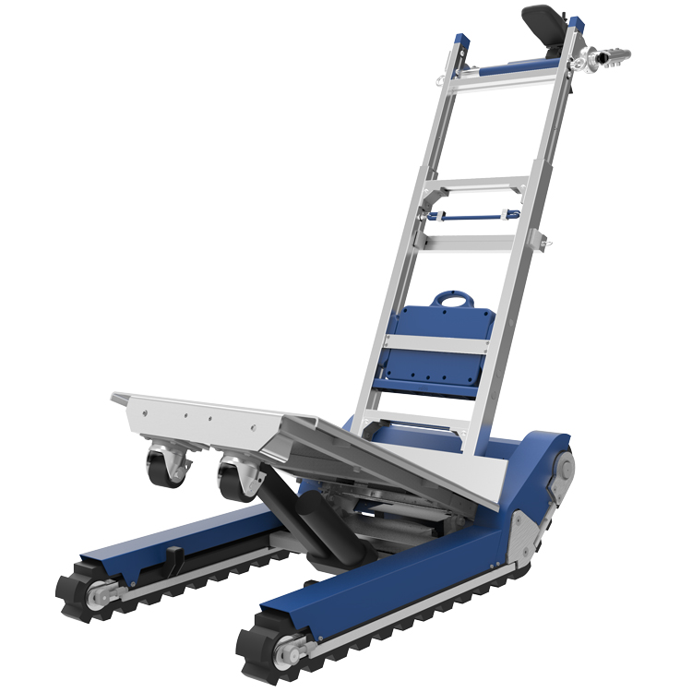
XS Range Electric Stair Climbing Sack Trucks
HI-XS2-CT420S

Slide 2

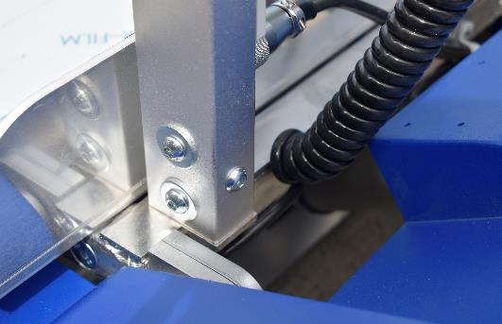
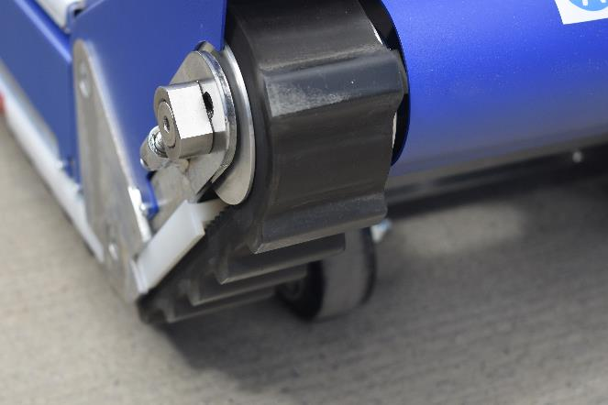
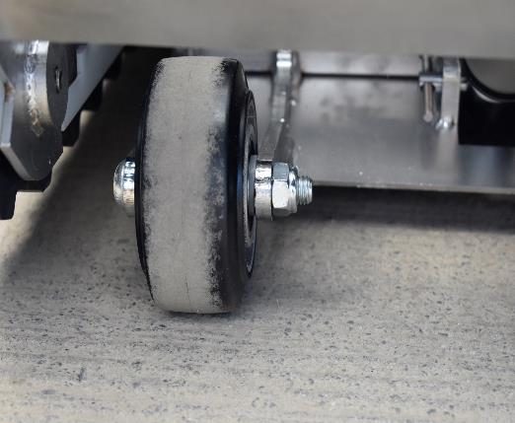
EQUIPMENT
Inspect Stair Climber:
All bolts and fixtures must be tight.
Crawler tracks must not be visibly damaged.
Do not use if the tracks are damged.
The wheels must be in good condition with no visible damage.

Slide 3
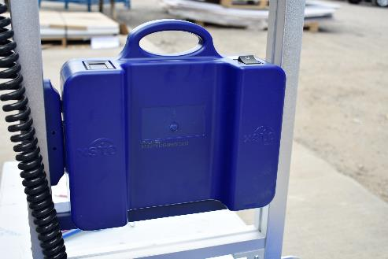
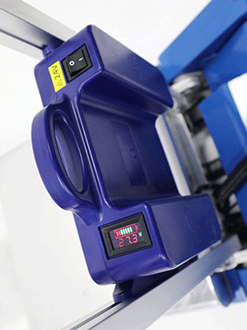
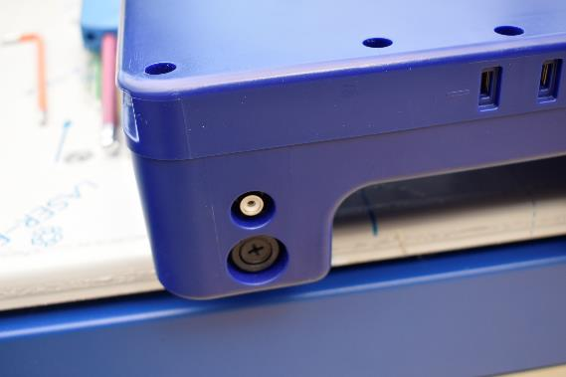
Battery:
There is no visible damage to the battery case.
The battery has sufficient charge for the task.
Ensure that the fuse is correctly in place.
Is a spare battery available.
Battery charging procedure is understood.
Are operators aware of the difference between 24V & 48V batteries as these are NOT interchangeable.

Slide 4
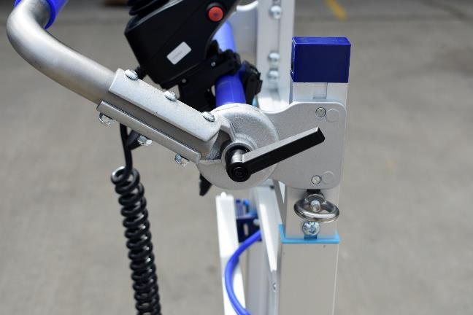
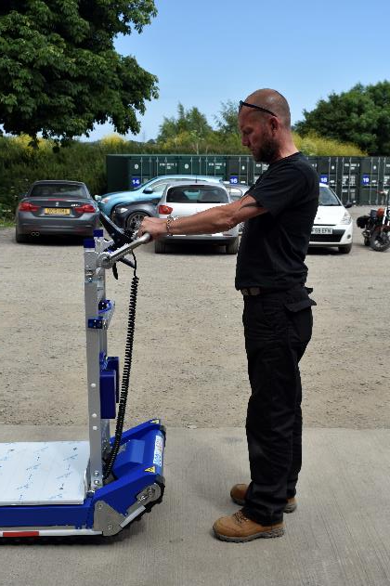
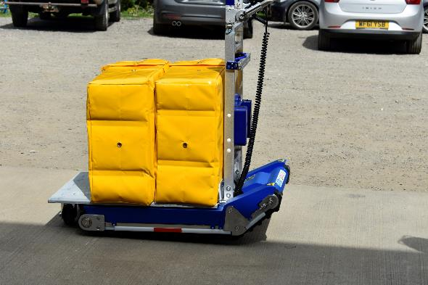
Handle:
Has the handle been suitably tightened.
Has the handle been adjusted to suit the operators height.
Has the handle been fully assembled.
Capacity:
Is the load suitable for the SWL of the
unit (420KG).

Slide 5
PERSON
Physical Capability:
Does the operator have the required upper body strength to control the load.
Does the operator have the stamina to complete the task.
User Training:
It is highly recommended that the operators practices using the CT420S without a load until competent and confident.
Has the operator undertaken this training course in full and understood the requirements for safe use.

Slide 6
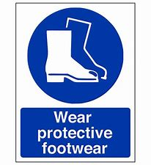

PPE
PPE:
Is appropriate safety footwear being worn.
Is the operator wearing a High Visibility Vest.
The operator doesn’t have any loose clothing that could be snagged during the operation.

Slide 7
ENVIRONMENT
Staircase Size:
Is the staircase wide enough to allow for free movement and safe operation.
Are landings large enough to allow the stair climber to be safely turned.
Are the stairs and landings capable to take the combined weight of the load, the user and the stair climber.
Are bannisters / hand rails in place.

Slide 8
ENVIRONMENT
Staircase / General Conditions:
All floor surfaces are dry and free from any loose material.
Is the lighting adequate for the task.
Nose of the stairs are clearly identified and of solid construction.
Do not use in wet, rainy, snowy or icy conditions.
Other People / Traffic:
If the route forms part of a designated fire escape / emergency route, have all the necessary people been notified of the task.
Have the stairs and landings been closed for the duration of the task, are suitable warning signage in place.

Slide 9
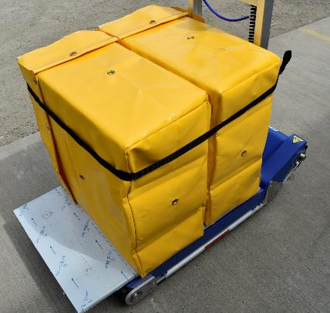
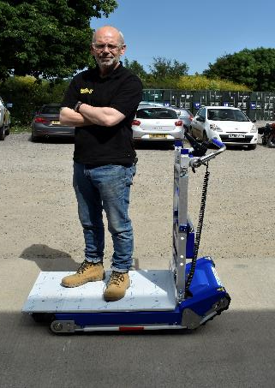
LOAD
Load:
Does the load have a stable centre of gravity.
Is the load suitable for the size of the load bed. Ensure the load does not exceed the front of the load bed, and no wider than 3 times the width of the load bed.
If moving hazardous chemicals, have they been appropriately and safely secured.
Is the load strong enough to support it’s own weight.
Use the strapping bar to securely strap the load to the stair climber.
Ensure that the load isn’t interfering with the wheels or tracks of the stair climber.
Only use for the movement of cargo, NOT people.

Slide 10
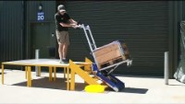
HOW TO ASCEND

Slide 11
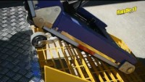
HOW TO DESCEND

Slide 12
Specification
Model | CT420S
Item Weight | 98KG
Maximum Loading Capacity | 420KG
Battery Capacity | 1400 – 1600 Steps
Upstairs Speed (Full Load) | 10 steps / Min (Load Speed), 13 steps / Min (High Speed)
Downstairs Speed (Full Load) | 13 steps / min, 16 steps / min
Minimum Platform Size | 1500 x 1500mm (stairs corner)
Operational Noise Level | <70dB
Protection Grade | IP54
Staircase Requirement | Height <21cm

Slide 13

KNOWLEDGE TEST
Person: __________________ Company: ____________________ Date: _____________
No | Question | True | False
1 | Bolts and fixing do not always need to be checked prior to use
2 | It is acceptable to use the CT420S if there are visible signs of damage to the crawler tracks
3 | The CT420 must not be used if the wheels are damaged
4 | There is a visible crack in the battery case but it is still OK to operate the CT420S
5 | The battery display is indicating 2% charge but it will be OK to use the CT420S to climb 5 flights of stairs
6 | Only a 48V battery is available, but it is OK to continue to use the CT420S
7 | The handle needs to be tight and in the correct position prior to use
8 | The maximum load that the CT420 can carry is 200kg
9 | Safety footwear should always be worn when operating the CT420S
10 | The CT420S can be used without any prior training and demonstration of competency

Slide 14
KNOWLEDGE TEST
Person: __________________ Company: ____________________ Date: _____________
No | Question | True | False
11 | The staircase to be navigated must be wide enough to ensure safe operation
12 | It is acceptable to transport a load up and down stairs on the CT420S in poorly lit conditions
13 | The CT420S should not be used if the floor surface is wet
14 | The CT420S can be used outside if it is raining
15 | Other people are permitted to use the same stairs when the CT420S is being used
16 | Warning signs must always be displayed whilst the CT420S is in operation
17 | The load must always be of a suitable size to suit the load bed
18 | The load should be no wider than 3 times the width of the load bed
19 | The load must always be securely strapped to the CT420 using the strapping bar
20 | Other employees can be safely moved around whilst stood on the load bed

Slide 15
KNOWLEDGE TEST
Person: __________________ Company: ____________________ Date: _____________
No | Question | True | False
21 | The load must be tilted fully forwards before starting to climb
22 | You must always stand upright when operating the stair climber.
23 | The stair climber must be in Auto Levelling mode before starting to climb.
24 | The stair climber can be safely operated without holding the handle.
25 | The stair climber must be stopped at the balance point at the top of the stairs.
26 | A blue line on the stair climber indicates the balance point.
27 | The rear wheels raise and lower automatically
28 | The rear wheels must be lowered until they are 25mm above the floor.
29 | When descending stairs there is no need to stop at the balance point.
30 | When descending stairs the rear wheels must be lowered at the balance point, and then raised before descending the stairs.

Slide 16
KNOWLEDGE TEST
Congratulations you have completed this part of the course.
Send the KNOWLEDGE TEST to info@handle-it.com for marking and the issue of your certificate.
We STRONGLY ADVISE that you practice using the stair climber unloaded and build confidence and skill.

